Slide 1
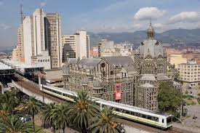
Place and Format for Convenience Stores in Medellín - Colombia
Daniel lema
December 2019

Slide 2
Agenda
Introduction
Data Gathering and Preparation
Results
Population profiling
Criminal profiling
Commercial Profiling
Conclusion

Slide 3
Introduction
Colombia is a country located north of South America, with an estimated population of 48 million people, and a GDP of US$744,696 or US$14,943 per capita, on a territory of 1,140,000 km², the area of Portugal, Spain, and France together. The main cities are Bogotá, the country's capital with a population of 7.1 million people, followed by Medellín with a metropolitan area of 3.7 million people, Cali (2.4 million people), and Barranquilla (1.2 million people).
As investors in the convenience store business, we are interested in invest in different Colombian cities, starting by Medellín. We need to determine places to locate our first two to three stores, considering population, and safety.
We are also interested in determining the store format to be promoted, being either the European or American store format

Slide 4
Data Gathering and Preparation
For this study we used public available information:
Population data and geographic polygons on Medellín administrative divisions: published by Medellín City Bureau and available at https://www.medellin.gov.co/irj/portal/medellin
National Criminal Records: published by National Police Bureau at https://www.policia.gov.co/grupo-informaci%C3%B3n-criminalidad/estadistica-delictiva
Commercial information on cities around the world, including Medellín, available at Foursquare.com
For a detailed description of the procedure utilized, consult our github resources at https://github.com/dlema65/Data-Science-Capstone-4th-Week/blob/master/Final%20Work.ipynb

Slide 5
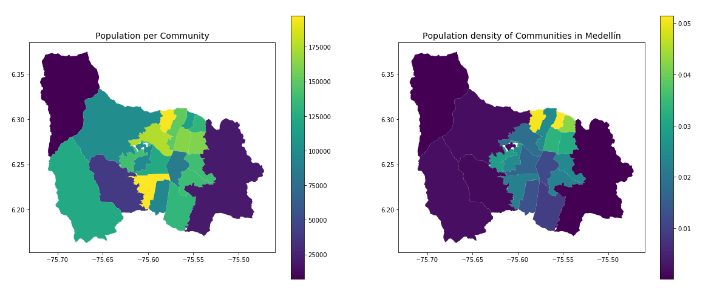
Population Profiling
Doce de Octubre
Doce de Octubre
Santa Cruz
Belén
The simple number of population may be misleading, given that different communities may be geographically dispersed (left map)
For this reason we based our study on population density (right map)

Slide 6
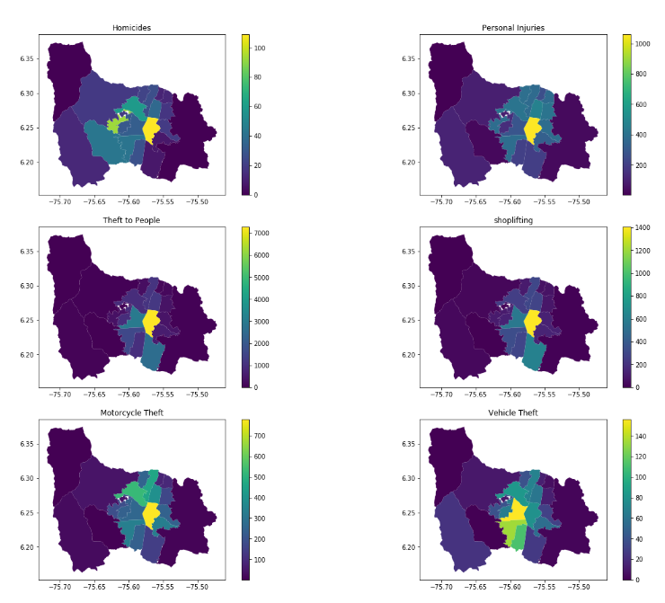
Criminal Profiling
Contrary to the common opinion regarding Doce de Octubre and Santa Cruz, their criminal records show that these communities does not have higher criminal activity than others. In fact, it has less incidence of shoplifting and theft to people.

Slide 7
Commercial Profiling
A KNN model was used to classify Medellín according to its commercial profiling
Model was trained with the 200 larger cities from Europe and 200 larger cities of United States of America.
Venues for these cities were obtained from Foursquare, then, they were one-hop encoded. The dataset was split in 80% for training and 20% for testing.
KNN model shows a hit rate of 97% on test data set.
Medellín commercial profile was found to be classified to be similar to a USA city
Care must be exercise. This classification only considers the type of venues present in the city.
No Macroeconomic or demographic information was used to classify the city.

Slide 8
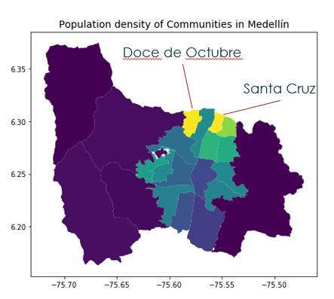
Conclusion
Considering the population density and low crime activity, it is suggested to invest in opening convenience stores in Doce de Octubre and Santa Cruz.
Considering the commercial profile for Medellín City, it is suggested to use the USA store format.
This procedure may be extended to be used on other Colombian cities, but data sources requires research and handful work, given the lack of consistency on data sources and some quality problems in the original data.

